Slide 1
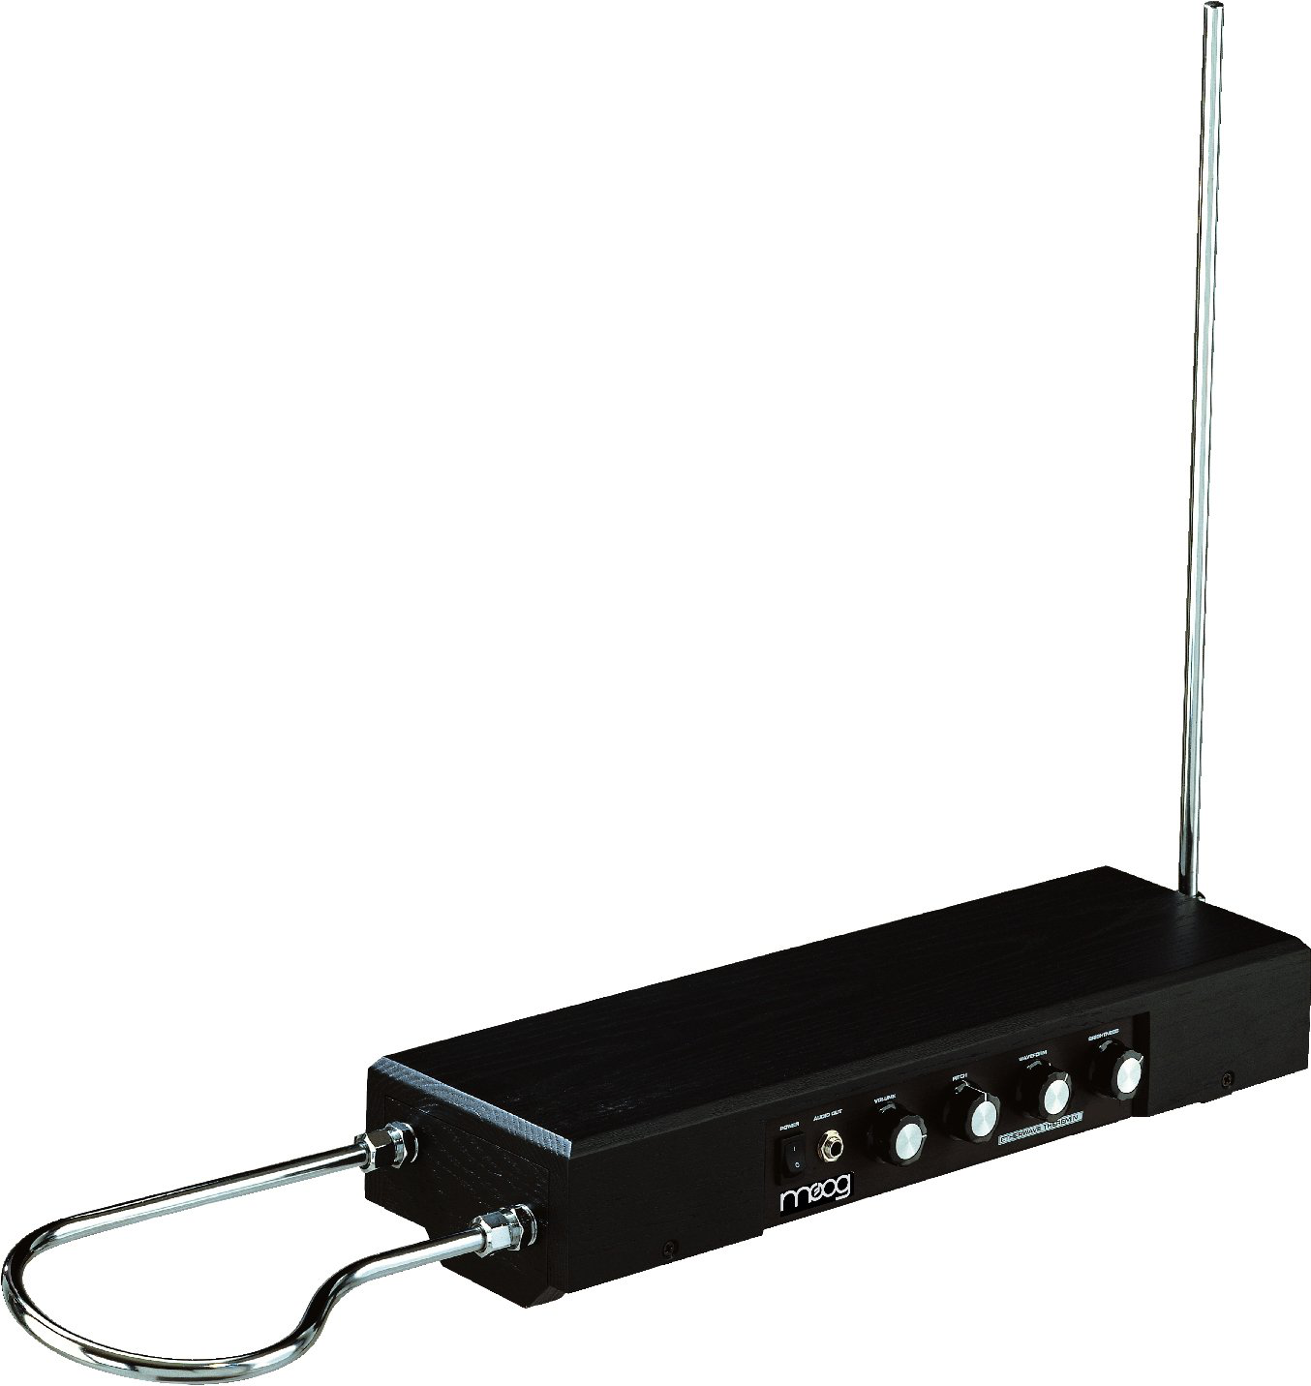
Theremin
Theremin picture?

Slide 2
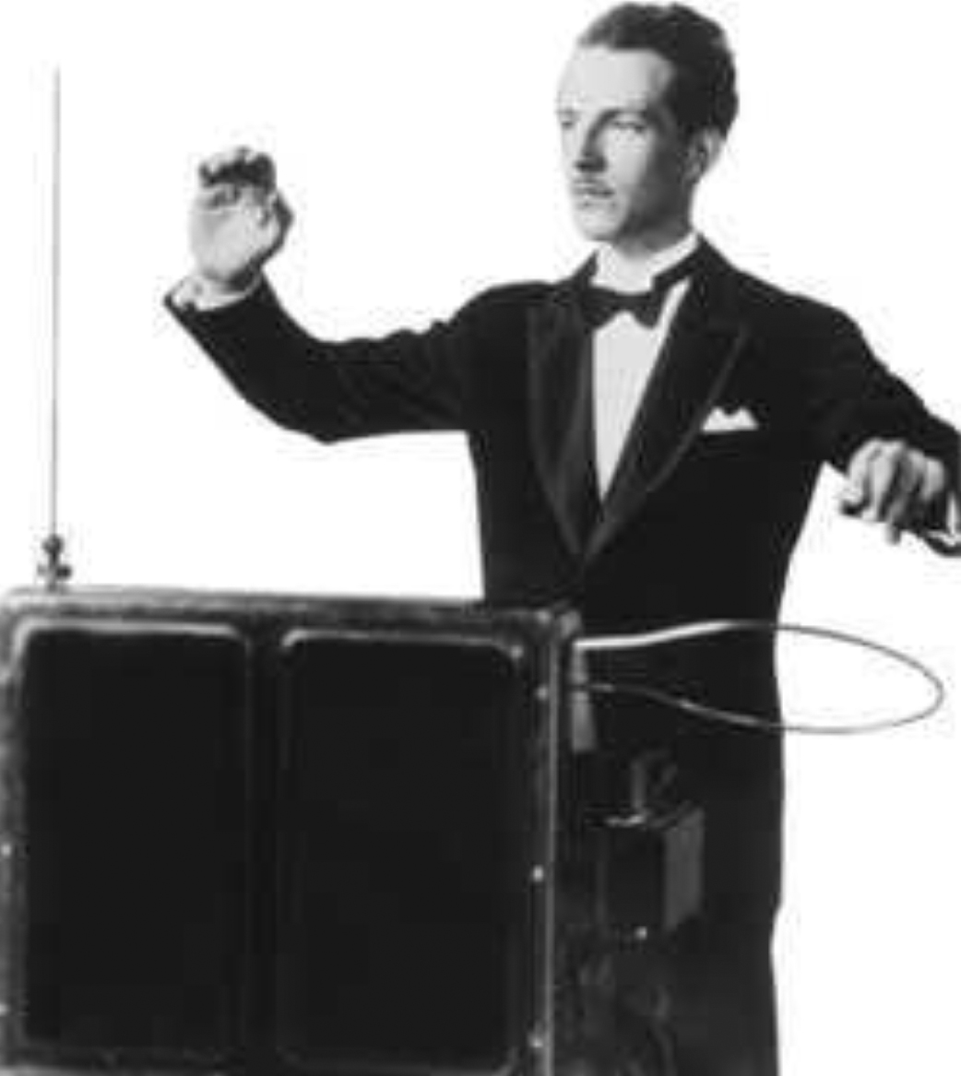
History

Slide 3
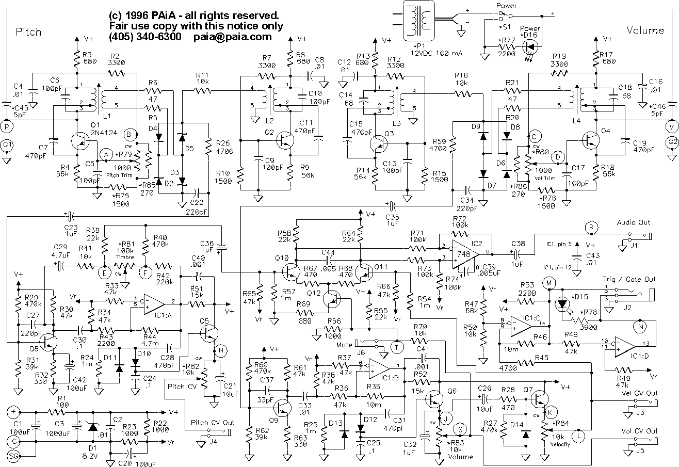
Basic Concept

Slide 4
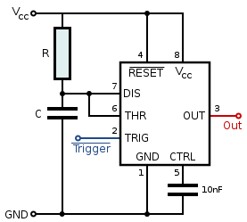
555 IC Timer Circuit

Slide 5
Two 555s

Slide 6
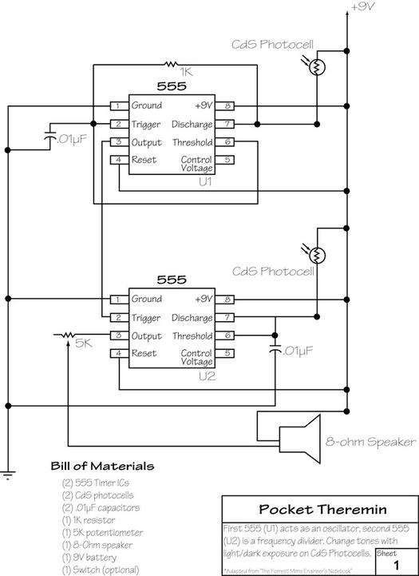
4046 VCO

Slide 7
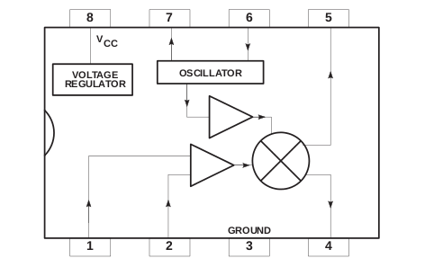
Mixer Circuit

Slide 8
555 Again

Slide 9
Conclusion – Where are we heading?

